Slide 1
Introduction to React and Redux
TuyLV/tuylv@vnpt.vn

Slide 2
Title and Content Layout with List
Single-page application
React
Redux
React Redux

Slide 3
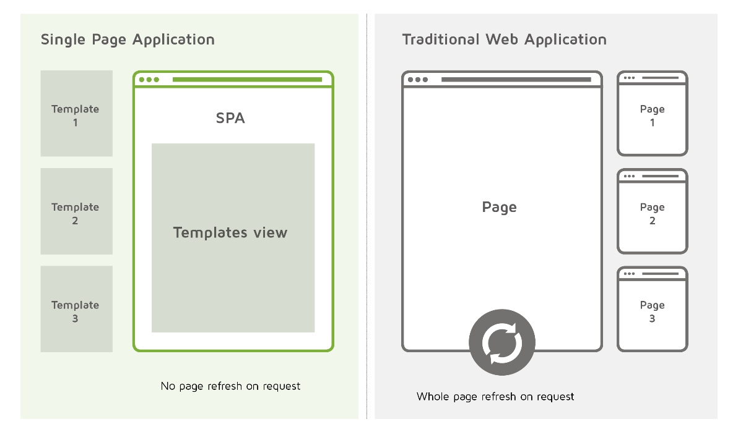
Single-page application (SPA)
A single-page application is an app that works inside a browser and does not require page reloading during use.
E.g. Gmail, Google Maps, Facebook or GitHub.

Slide 4
State-based approach
We manage state and view separately.

Slide 5

React
A JavaScript library for building user interface, built by an engineer at Facebook and released to the developer community under an open-source license in 2013.
Virtual DOM
Component-Based
One-way data flow
Learn Once, Write Anywhere

Slide 6
Add a Slide Title - 1

Slide 7
Add a Slide Title - 2

Slide 8
Add a Slide Title - 3

Slide 9
Add a Slide Title - 4

Slide 10
Add a Slide Title - 5

Slide 11
Add a Slide Title - 6

Slide 13
Add a Slide Title - 7

